Slide 1
Comprehensive Digital Marketing Project Work

Slide 2
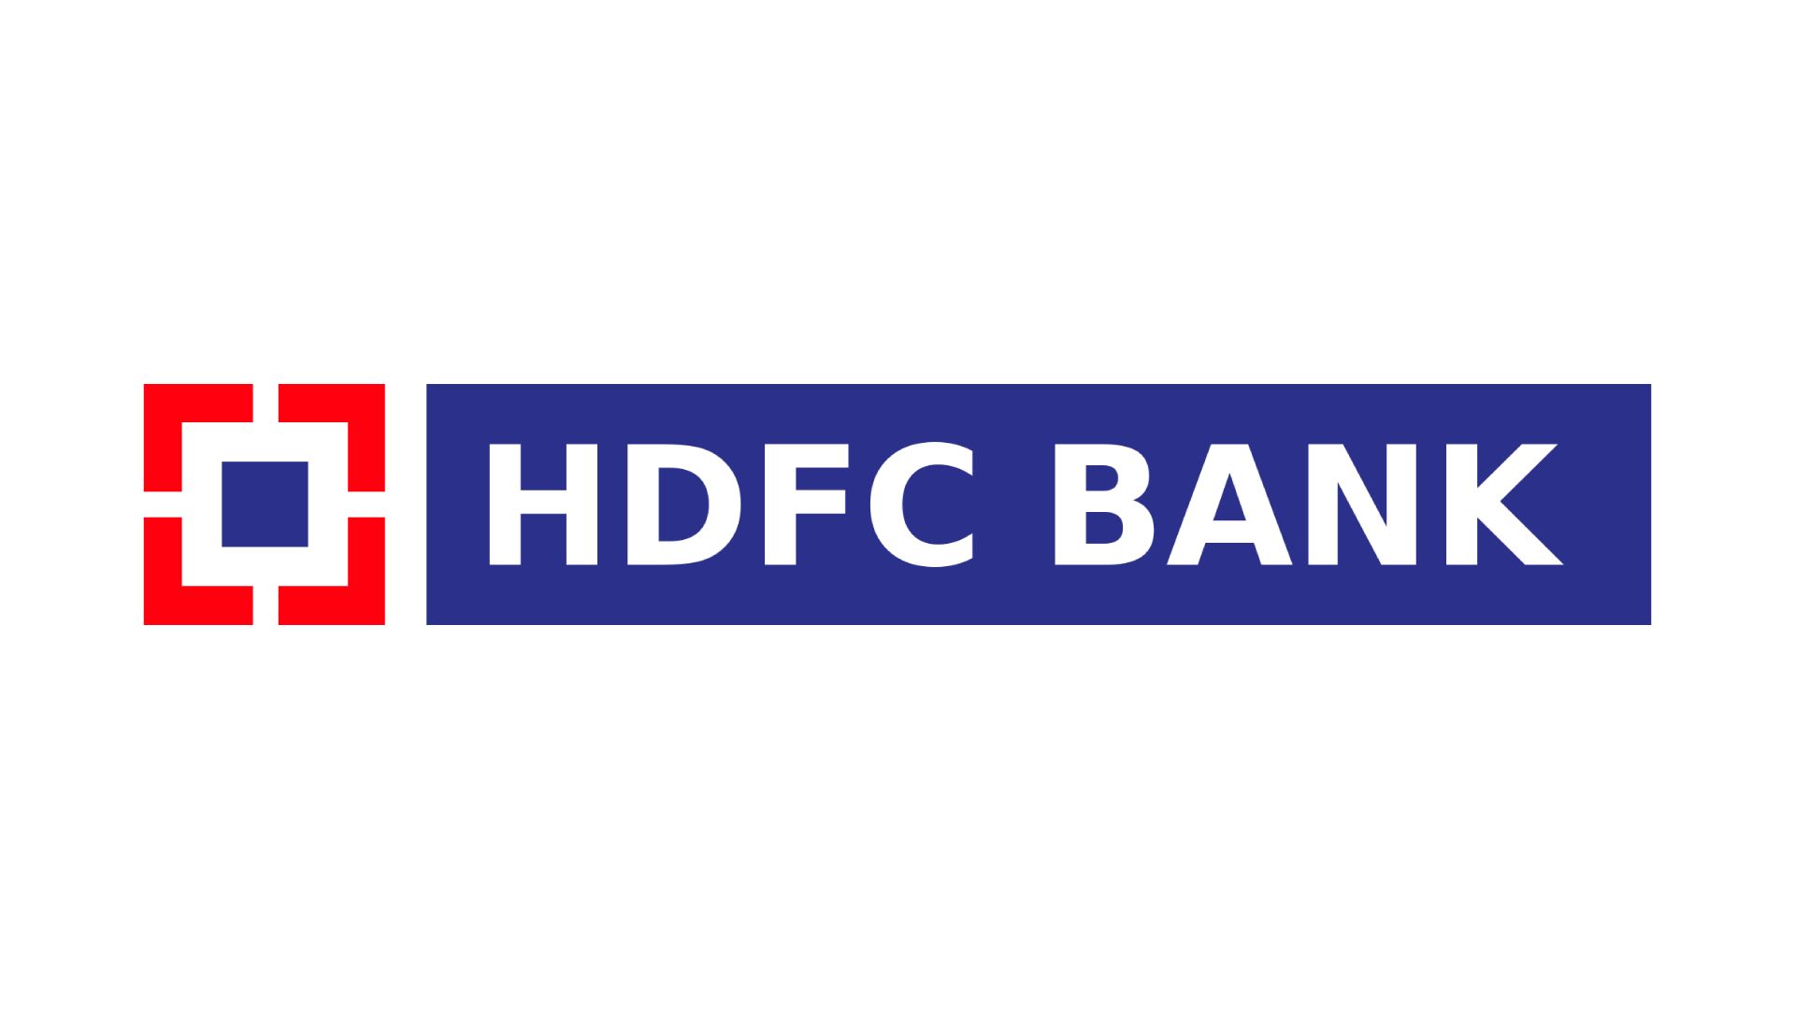
Part 1: Brand study, Competitor Analysis & Buyer’s/Audience’s Persona
COMPANY/TOPIC for project: HDFC BANK
Research Brand Identity: Study the brand's mission, values, vision, and unique
selling propositions (USP).
Brand colours:
White,blue,red
LOGO
Mission/Values: HDFC Bank’s mission is to be a world class Indian bank. We have a two-fold objective: first, to be the preferred provider of banking services for target retail and wholesale customer segments. The second objective is to achieve healthy growth in profitability, consistent with the bank’s risk appetite.
USP: HDFC Bank Limited is an Indian banking and financial services company headquartered in Mumbai, Maharashtra. HDFC Bank is India’s largest private bank by assets and by market capitalization ( as of April 2021). It is the third-largest company by market capitalization ($145 billion) on the Indian stock exchanges. It is also the fifteenth largest employer in India with nearly 120,000 employees.

Slide 3
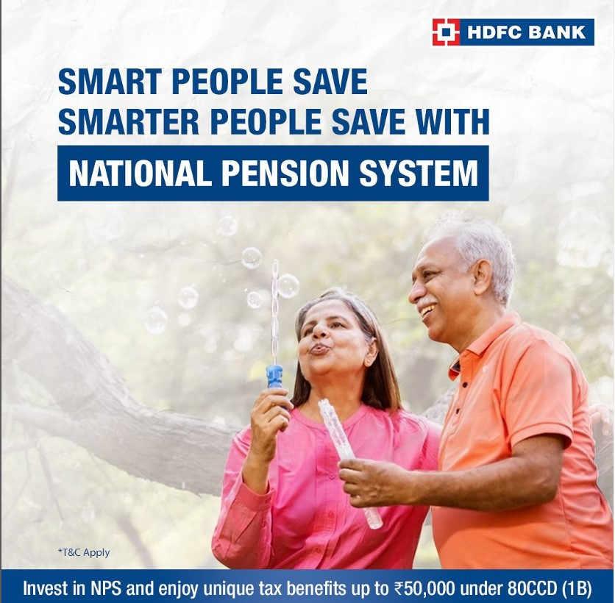
Part 1: Brand study, Competitor Analysis & Buyer’s/Audience’s Persona
COMPANY/TOPIC for project: HDFC BANK
Brand Messaging: Informativeecurity,Financial,
New scheme&intrest rate Updates
https://www.instagram.com/p/Ct6ZzRFrfGS/?utm_source=ig_web_copy_link&igshid=MzRlODBiNWFlZA==
tagline : we understand your world

Slide 4
Part 1: Brand study, Competitor Analysis & Buyer’s/Audience’s Persona
Competitor Analysis: Select three competitors operating in the same industry or
niche as the chosen brand, examine their USPs and online communication.
Competitor 1: ICICI BANK
https://www.icicibank.com/
USP:Accessibility - Get access to funds immediately on presenting exportcollection documentsEase - Immediate post-shipment export finance for open account trading(subject to approval)Efficient - Quick Turnaround time
Online comunication: provided toll free number and chat box
Competitor 2: kotak bank
https://www.kotak.com/en/home.html
USP:Kotak Mahindra Bank offers high interest rate savings account, low interest rate personal loan and credit cards with attractive offers. Experience the new age Personal Banking and Net Banking
Online comunication: chat box tollfree number and whatsapp saport
Competitor 3: YES BANK
https://www.yesbank.in/
USP:YES BANK Fixed Deposit – Open Fixed Deposit Account and avail attractive interest rates to the money you invest. Visit for more on YES BANK FD rates now PERSONAL
Online comunication: toll free number,chat box,online videos.

Slide 5
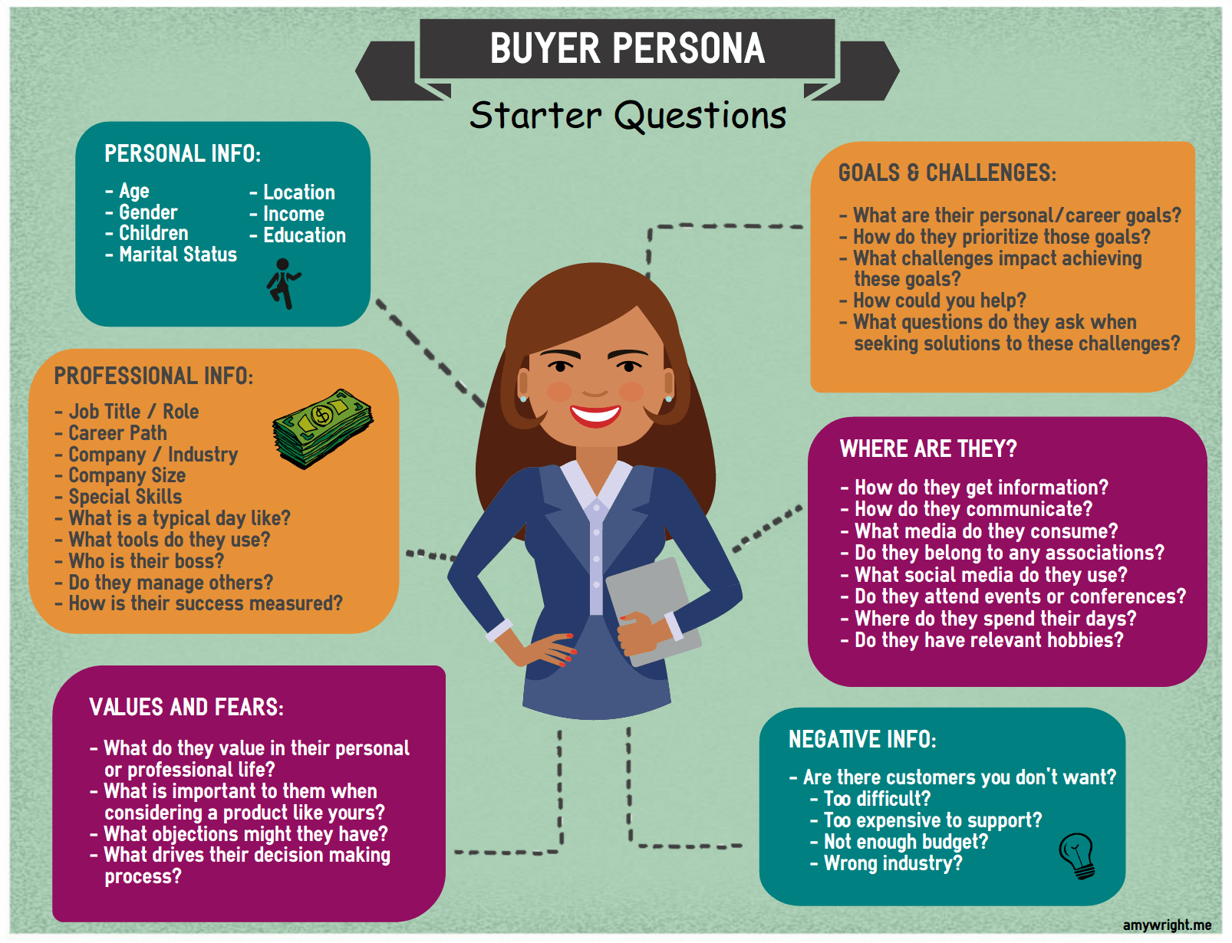
Part 1: Brand study, Competitor Analysis & Buyer’s/Audience’s Persona
Buyer's/Audience's Persona: Clearly define the target audience for the chosen
brand. Consider demographics, psychographics, behaviors, and interests.
HDFC BANK
Above18
Both male or female
No
married/unmarried
All over India
2,50,000 to 2,00,00,000 per annum
At least 10+2
Ads,youtube,instagram,community platforms like
Quora,facebook groups,TV
Social status,personal appearance
Long lasting,transaction fee,rate of interest ,services
Credit card ,lones, speed services

Slide 6
Part 2: SEO & Keyword Research
SEO Audit: Do an SEO audit of the brands website
Keyword Research: Define Research Objectives, Brainstorm Seed Keywords, Utilize Keyword Research Tools (SEMrush or Moz Keyword Explorer),Analyze Competitor Keywords, Long-tail Keyword Exploration (specific, longer phrases) that align with the research objectives and have lower competition but higher conversion potential.
On page Optimization: Meta Tag optimization & content optimization
Reflect on the process of conducting keyword research and the SEO recommendations
provided.
Document the challenges faced during the research and analysis phase, as well as the key
insights gained from the keyword research process.

Slide 7
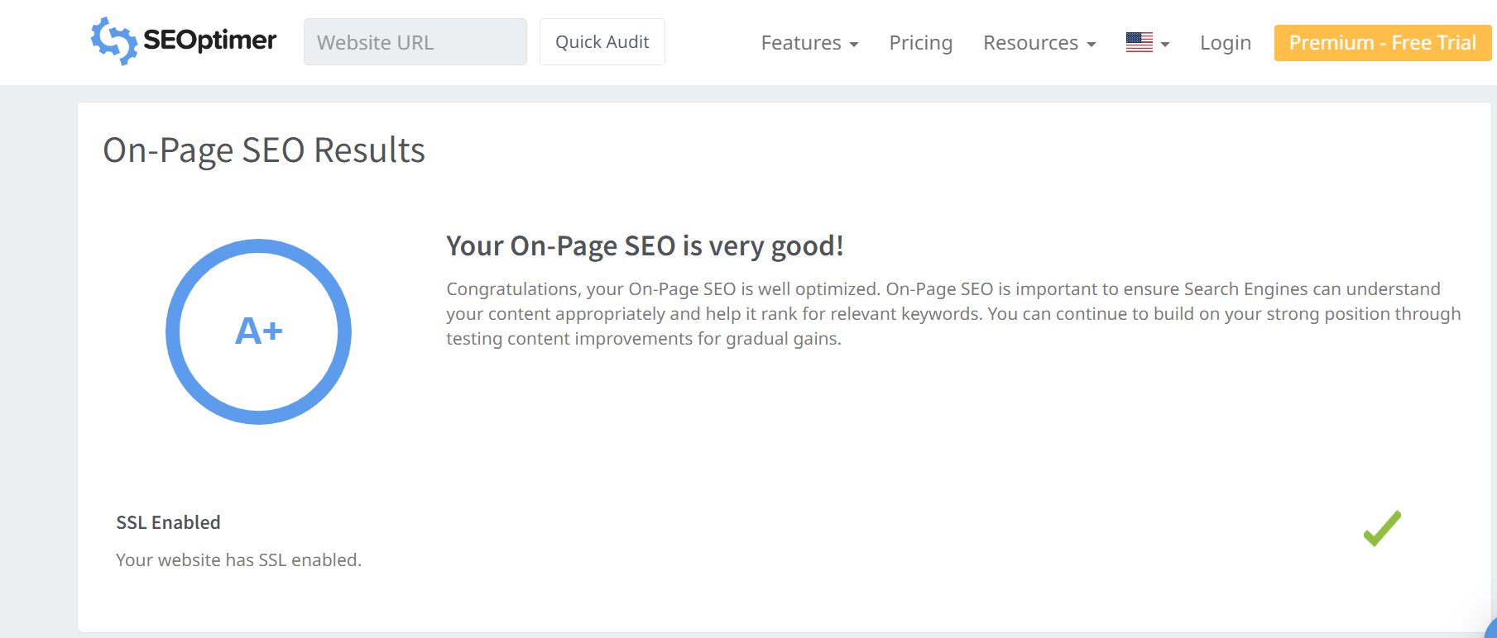
SEO Audit: Do an SEO audit of the brands website

Slide 8
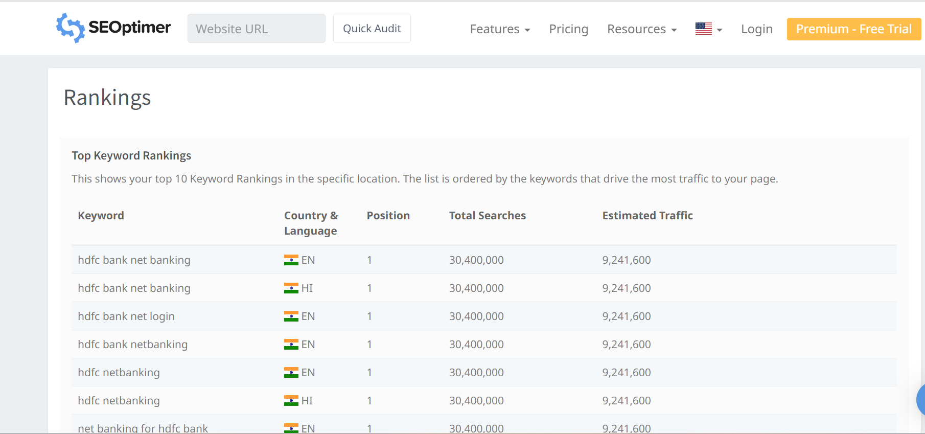

Slide 9
Keyword | Avg. monthly searches | Competition
home loan interest rate | 500000 | Low
mudra loan | 500000 | Low
student loans | 500000 | Low
Meta Tittle
Find the best loans like Home loan,Mudra Loan,Student loan |  |  | 58
Meta Description
Apply feautured Loans like Home loan, Mudra Loan, Student Loan from HDFC |  |  | 72

Slide 10
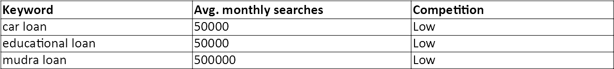
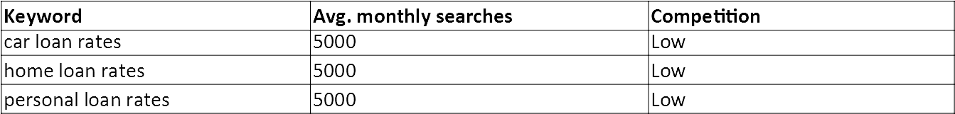
Keyword : Types of loans
Meta Title:
FInd the best loans like Car ,Educational & Mudra loans at HDFC Bank
Meta Description:
Apply now for the feautured loans like Car loan, Educational loan, Mudra loan at ICICI Bank 91
Keyword: rate of intrest
Meta Title:
Check the lowest loan rates of Car loan,Home loan,Personal loan 63
Meta Description:
Apply for lowest rates of Car loan, Home loan, Personal loan at HDFC Bank 74

Slide 11
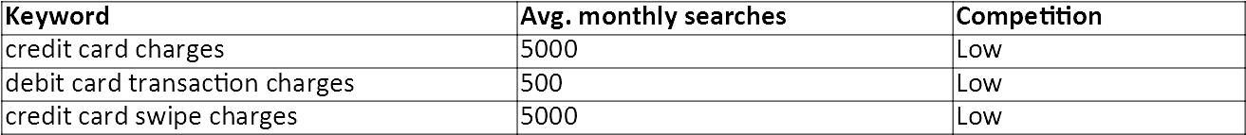
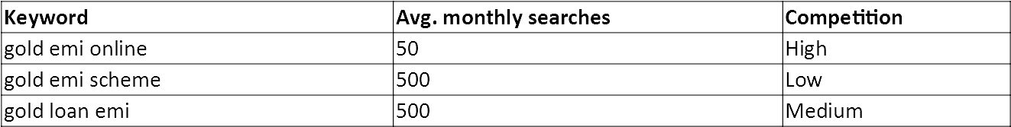
Keyword: Charges
Meta Title:
Check the charges of Credit card,debit card & credit card swipe charges 71
Meta Description:
Apply feautured Loans like Home loan, Mudra Loan, Student Loan from HDFC 72
Keyword: gold loan
Meta Tittle:
Explore new options like gold emi online,gold emi scheme,gold loan emi 70
Meta Description:
Check the interesting gold emi online, gold emi scheme,gold loan emi at HDFC Bank 82

Slide 12
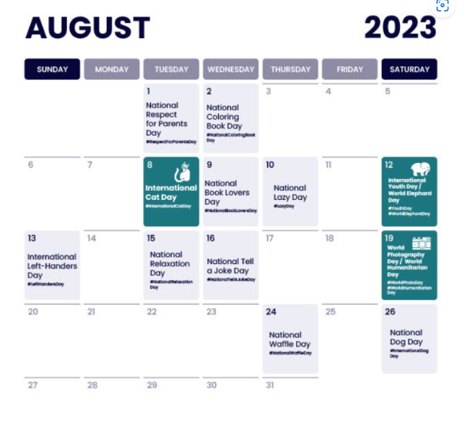
Part 3: Content Ideas and Marketing Strategies
Content Idea Generation & Strategy: Create a content calendar for the remaining month of July by brainstorming content themes, exploring various formats like blog posts, videos, infographics, podcasts, and interactive quizzes, and scheduling publication dates mainly on Facebook & Instagram.
And include the strategy, aim and the idea behind these posts and story
ExampleExampleExampleContent Calendar (Try creating a table for the month of July)

Slide 13
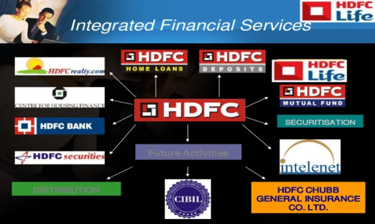
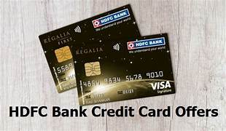
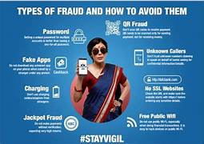
Part 3: Content Ideas and Marketing Strategies
Reflect on the content ideas and marketing strategies process, discussing the challenges encountered and lessons learned.
Date: 21st august 2023
To create awareness on HDFC bank online services.
Our bank launches for customers to apply credit card at online.
Using blog article
.
Date: 22nd august 2023
to promote newly launched credit cards.
In this video i visualised in a very brief manner
about different types of cards & its benefits.
Date: 23rd august 2023
awareness about frauds on digital transactions.
to create a meme frauds on digital marketing

Slide 14
Creating content ideas and devising effective marketing strategies is a dynamic process that involves continuous learning and adaptation. Throughout this journey, several challenges and valuable lessons can be encountered. 1.Understanding the Audience: One of the primary challenges is comprehending the target audience's preferences, needs, and pain points. 2. Generating Unique Ideas: Coming up with fresh and innovative content ideas can be difficult, especially in saturated markets. 3. Consistency and Quality: Maintaining a consistent flow of high-quality content can be demanding. Setting up an editorial calendar and adhering to a content creation schedule helps in maintaining quality and meeting deadlines. 4. Content Promotion: Even the best content may not gain traction without proper promotion. Crafting effective marketing strategies to reach the target audience across various channels is crucial for success. 5. Collaboration: Collaborating with influencers or other brands can amplify the reach of content and strengthen marketing efforts. The content ideas and marketing strategies process is an iterative and learning-oriented journey

Slide 15
Part 4: Content Creation and Curation (Post creations, Designs/Video Editing, Ad Campaigns over Social Media and Email Ideation and Creation)
Post Creation:
Select Content Categories: Identify three different content formats relevant to the chosen topic or industry. Research and Brainstorm: Research trending topics, industry news, or audience interests within each category. Brainstorm ideas for social media posts that align with each category. Do note that 1 content format has to be video and additionally 3 stories/status are to be created.
Format 1: Blog article
Format 2: Video
Format 3: Creative

Slide 16
Part 4: Content Creation and Curation (Post creations, Designs/Video Editing, Ad Campaigns over Social Media and Email Ideation and Creation)
Format 1: Blog article
Aim: To create awareness on HDFC bank online services
Date: 21st august 2023
Idea: Our bank launches for customers to apply credit card at online.
Topic:
A Step-by-Step Guide to HDFC Bank Credit Card Application Process Online
Step 1: Visit the HDFC Bank Website : To begin your credit card application process, go to the official HDFC Bank website ().
Step 2: Navigate to 'Credit Cards' Section : Once on the HDFC Bank homepage, find the 'Credit Cards' section. Click on it to proceed to the credit card offerings.
Step 3: Explore Credit Card Options : In this step, you will be presented with a range of credit card options offered by HDFC Bank. Each card comes with its own set of features, benefits, and eligibility criteria. choose the one that best suits your needs and lifestyle.
Step 4: Check Eligibility :After selecting a specific credit card, you will need to check your eligibility for the chosen card

Slide 17
Step 5: Fill out the Application Form :If you meet the eligibility criteria, proceed to fill out the online application form. You will be required to provide personal details. Step 6: Submit Documents :Once you have completed the application form, the next step is to submit the necessary documents to support your application. Commonly required documents. Scan or upload the required documents in the prescribed format as mentioned in the application form. Step 7: Agree to Terms and Conditions :Before proceeding, carefully review the terms and conditions of the credit card application. Understand the fees, interest rates, and any other charges associated with the card. Tick the box to agree to the terms and conditions. Step 8: Await Approval :After submitting your application, HDFC Bank will review your details and documents. The bank may get in touch with you for verification or additional information if needed. The approval process may take a few days. Then You will receive your new HDFC Bank credit card at your registered mailing address.

Slide 18
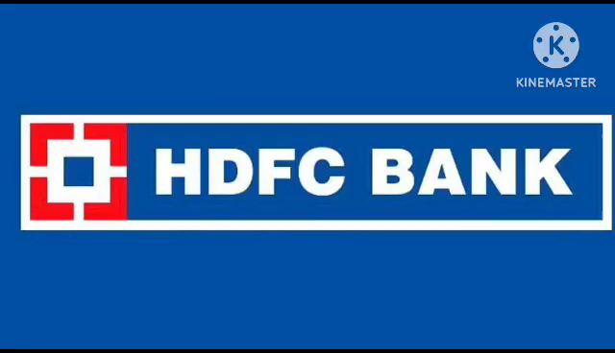
Part 4: Content Creation and Curation (Post creations, Designs/Video Editing, Ad Campaigns over Social Media and Email Ideation and Creation)
Format 2: video
Aim: to promote newly launched credit cards
Date:22nd august 2023
Idea : Credit Card & its Different types in HDFC Bank
Topic: In this video i visualised in a very brief manner about different types of cards & its benifits

Slide 19

Part 4: Content Creation and Curation (Post creations, Designs/Video Editing, Ad Campaigns over Social Media and Email Ideation and Creation)
Format 3: Creative
Aim: awareness about frauds on digital transactions
Date:23rd august 2023
Idea: to create a meme frauds on digital marketing
Topic: meme

Slide 20
Part 4: Content Creation and Curation (Post creations, Designs/Video Editing, Ad Campaigns over Social Media and Email Ideation and Creation)
Instagram Story
Utilize the Stories feature on Instagram for three consecutive days. Share behind-the-scenes glimpses, polls, quizzes, or sneak peeks etc to encourage audience participation. Once uploaded use the story highlight feature on Instagram and save the 3 story with an appropriate name for each.
Note:
Once done monitor the performance of the posts and Stories using the insight tool and analyze the engagement metrics (likes, comments, shares, impressions, etc.). Based on the analysis, mention the strategies and areas for improvement.

Slide 21
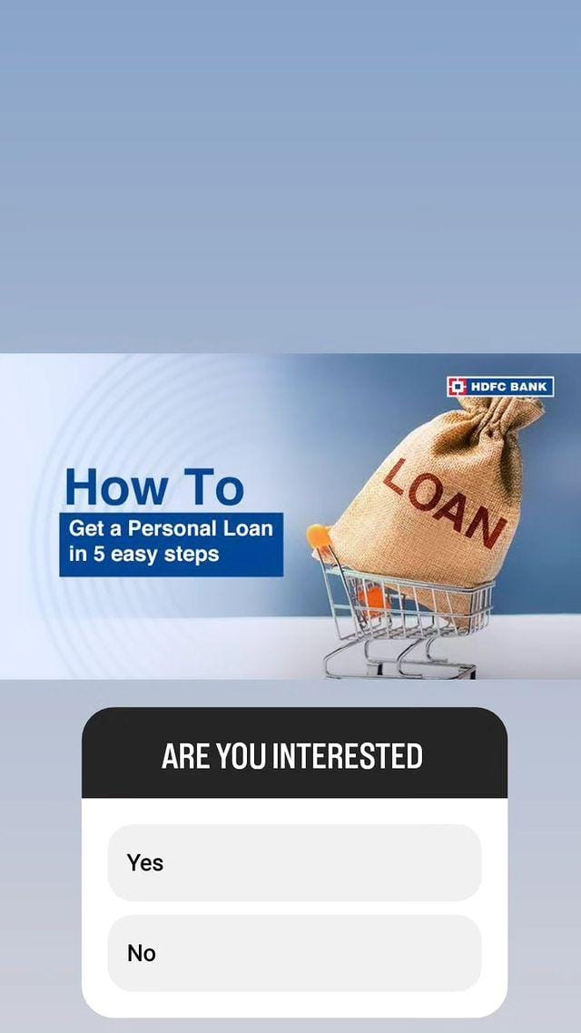
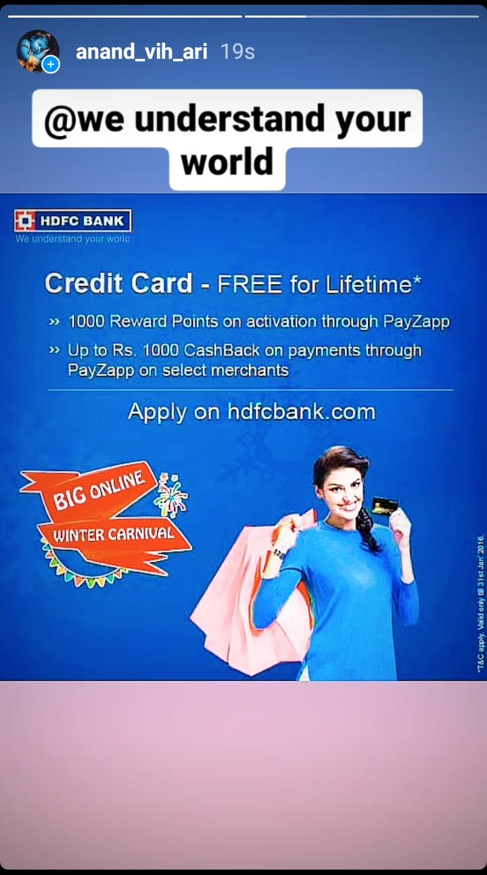
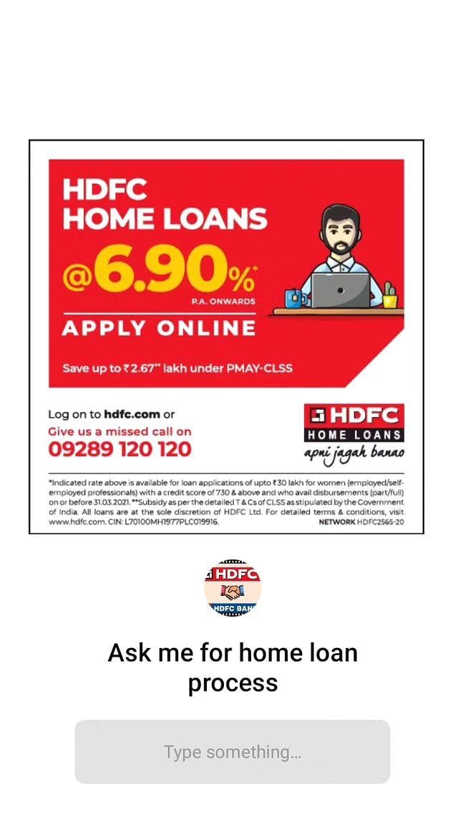
Part 4: Content Creation and Curation (Post creations, Designs/Video Editing, Ad Campaigns over Social Media and Email Ideation and Creation)
Instagram Story

Slide 22
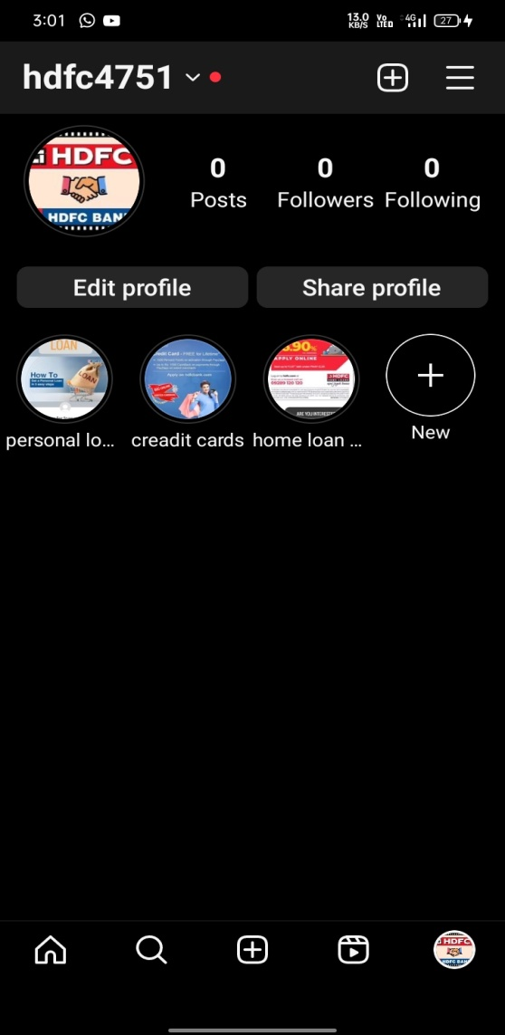

Slide 23

Part 4: Content Creation and Curation (Post creations, Designs/Video Editing, Ad Campaigns over Social Media and Email Ideation and Creation)
Designs/Video Editing
Design Tools Familiarization (use Canva for creating visually appealing graphics)
Video Creation: Utilize VN or any video editor of your choice to create videos related to the
chosen topic.

Slide 24
Part 4: Content Creation and Curation (Post creations, Designs/Video Editing, Ad Campaigns over Social Media and Email Ideation and Creation)
Social Media Ad Campaigns
Ad Campaigns over Social Media:
Come up with 3 ad campaigns each covering one of the mentioned goals: brand awareness, driving website traffic, or generating leads

Slide 25
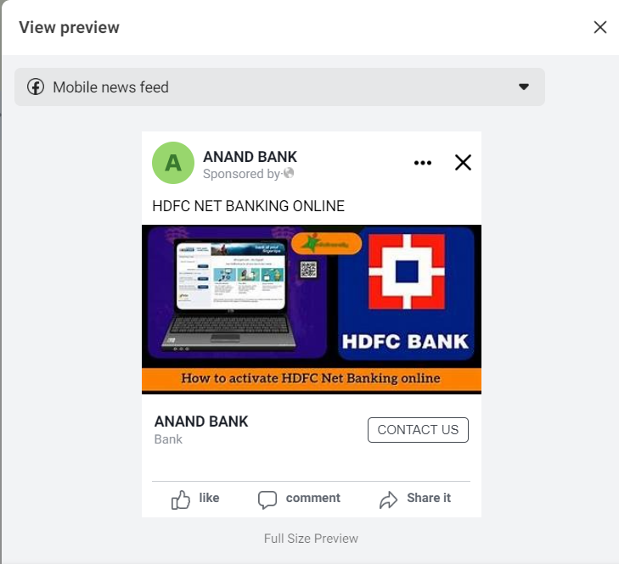
Brand awareness:
Targeting : Location : India,All genders ,
Age , Interest : SBI bank,YES bank.

Slide 26
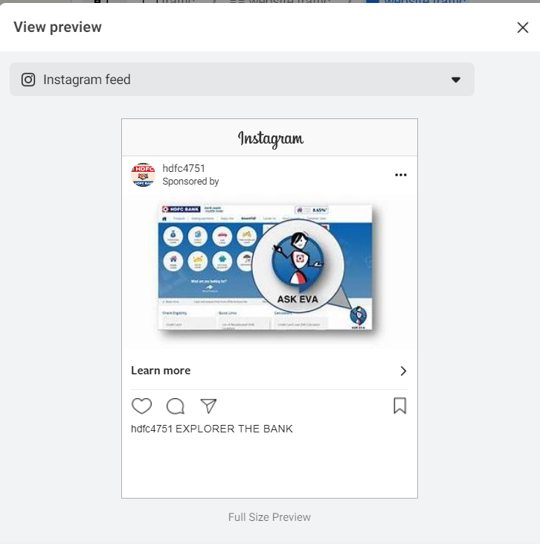
Driving website traffic:
Targeting : Location : India,All genders ,
Age , Intrest : SBI bank,YES bank.

Slide 27
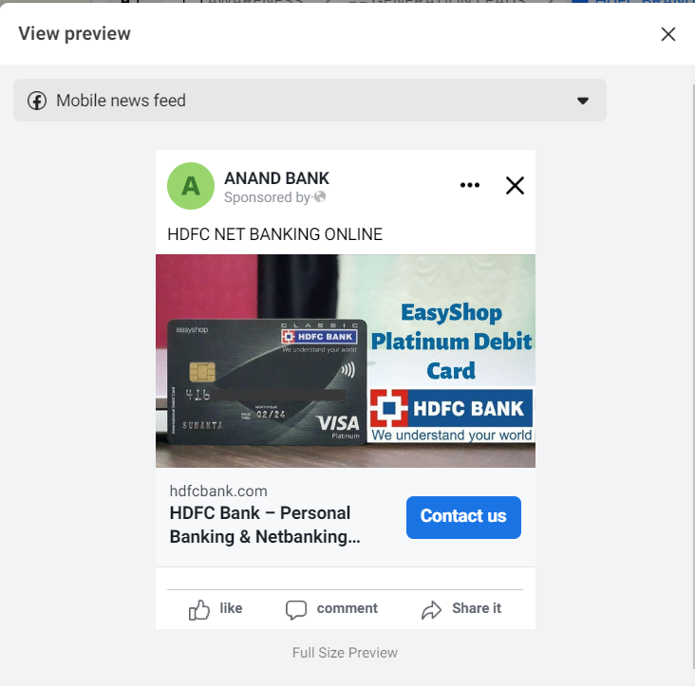
Generating Leads:
Targeting : Location : India,All genders ,
Age , Intrest : SBI bank,YES bank

Slide 28
Part 4: Content Creation and Curation (Post creations, Designs/Video Editing, Ad Campaigns over Social Media and Email Ideation and Creation)
For every campaign clearly define:
Advertising Goals: increasing brand awareness, driving website traffic, or generating leads.
Audience Targeting: Define the target audience for the ad campaigns based on demographics, interests, and behavior.
Ad Creation: Create visually appealing ad creatives, compelling ad copy and relevant call-to- action.

Slide 29
Part 4: Content Creation and Curation (Post creations, Designs/Video Editing, Ad Campaigns over Social Media and Email Ideation and Creation)
Email Ad Campaigns
Ad Campaigns for email marketing:
Come up with 2 email ad campaigns with the mentioned goals: brand awareness & generating leads

Slide 30
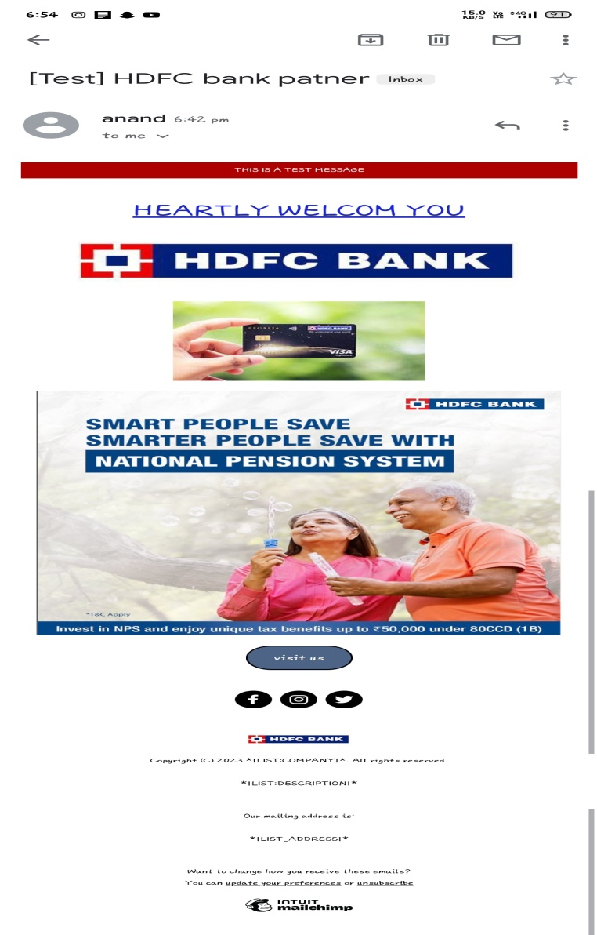
Email Ad Campaign 1 - Brand Awareness (insert emailer image)

Slide 31
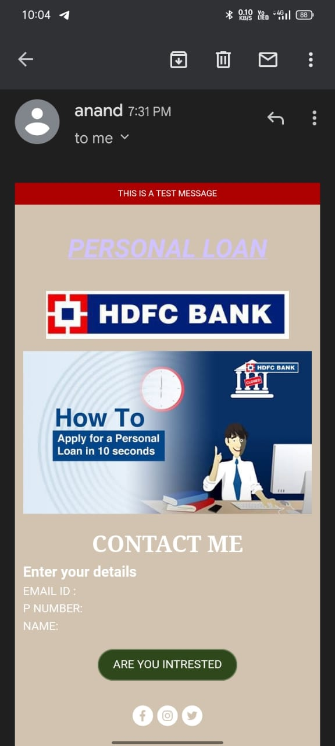
Email Ad Campaign 2 - Lead Generation (insert emailer image)

Slide 32
Part 4: Content Creation and Curation (Post creations, Designs/Video Editing, Ad Campaigns over Social Media and Email Ideation and Creation)
Reflect on the content creation and curation process, discussing the challenges faced and
lessons learned.
1. Consistency is Key: Maintaining a consistent tone, style, and frequency of content across platforms helps reinforce brand identity and improves audience recall.
2.Visual Appeal: Eye-catching visuals, well-designed graphics, and professionally edited videos can significantly enhance the impact of content and ad campaigns.
3. A/B Testing: Regularly conducting A/B + tests for ad campaigns and email subject lines allows for data-driven optimization and better results.
4.Know our Audience: Understanding the target audience's interests, pain points, and preferences is fundamental in creating relevant and engaging content.
5. Engage with the Audience: Responding to comments, messages, and feedback from the audience fosters a sense of community and builds trust.
6. Long-Term Approach: Content creation and marketing are not one-time endeavors. A long-term, strategic approach is necessary to build brand awareness and achieve sustainable growth.
In conclusion, content creation and curation, along with thoughtful design, video editing, and well-executed ad campaigns, play a pivotal role in a successful marketing strategy. By understanding the challenges and incorporating the lessons learned, businesses can create compelling content that resonates with their target audience and drives results

